Slide 1
Multi-threaded web crawler
Presented By:
Naqi Turab – 36520
Ammar Iftikhar – 35441

Slide 2
Table of content
Introduction
Goals & Features
Web Crawler Architecture
Implementation
Technologies
Challenges & Solutions
Conclusion

Slide 3
introduction
A multi-threaded web crawler is designed to fetch web pages efficiently and store the extracted data in a structured database.
This implementation supports concurrency, URL queue management and database integration for data analysis.

Slide 4
Goals & features
Fast and concurrent web crawling using multi-threading.
URL queue management to avoid duplicates.
Database integration using SQLite for structured storage.
Error handling for broken links and timeouts.
Scalable design for larger datasets.

Slide 5
Web crawler architecture
Manages threads and overall crawling.
Provides thread safe URL queueing.
Handles SQLite database interactions.
GUI to view
Crawled
Data.
Web crawler
URL Queue
Database Manager
SQLite Viewer

Slide 6
Implementation workflow
1
2
4
3
5
Seed URLs are added to the queue.
Worker threads fetch URLs and crawl their content.
Extracted data is stored in SQLite database.
Links are added back to the queue for further crawling.
SQLite viewer displays data

Slide 7
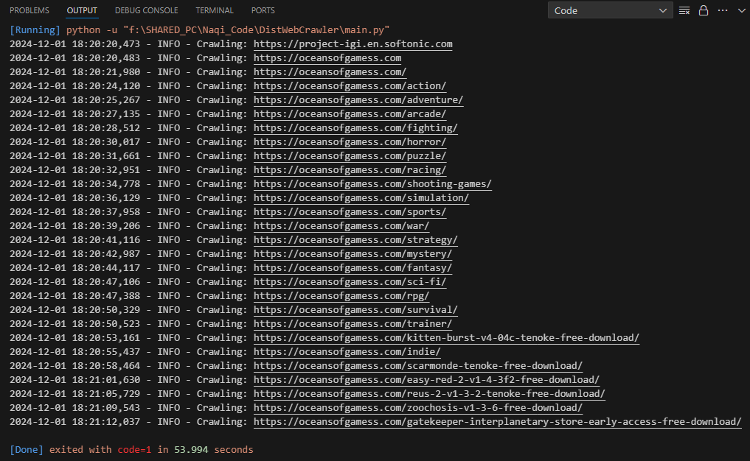
Project demonstration 1/2
Crawling
multiple
URLs.

Slide 8
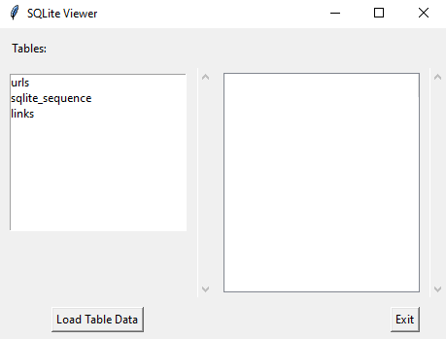
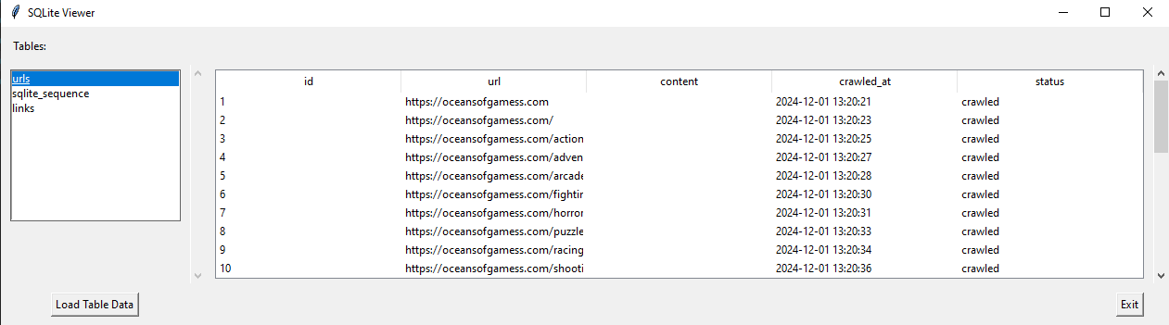
Project demonstration 2/3

Slide 9
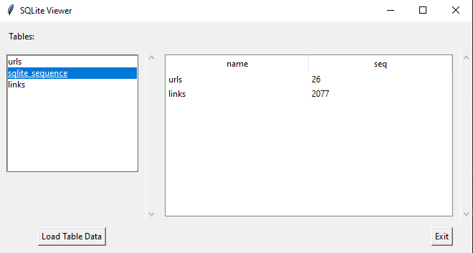
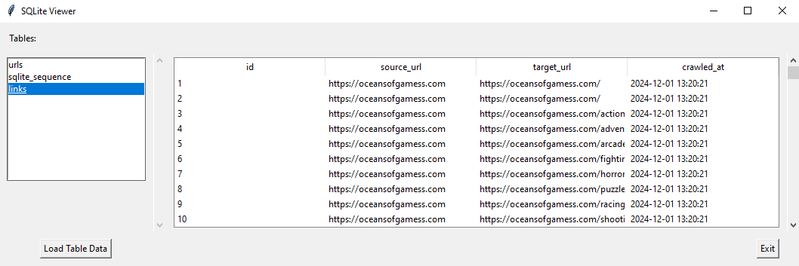
Project demonstration 3/3

Slide 10

Technology used
Python for programming.
Beautiful-Soup for web scraping.
SQLite for database management.
Tkinter for Graphical User Interface.
Multi-threading for concurrency.

Slide 11
Challenges & solutions
Concurrency Management.
Error Handling.
Data Duplication.
Scalability.
Achieved using thread-safe URL queue.
Managed timeouts & broken links with robust exception handling.
Prevented using a set of visited URLs.
Designed system to handle large datasets and multiple threads.

Slide 12
conclusion
The multi-threaded web crawler efficiently fetches, process and stores web data in SQLite (database. DB)
The modular design supports scalability, error handling and provides a user-friendly interface for viewing results.

Slide 13

Thankyou

